Slide 1
Code of Ethics for Engineers
ENGI2304
Yuxuan Zhang

Slide 2


Slide 3
Code of Ethics for Engineers
Hold paramount the safety, health, and welfare of the public
If engineers’ judgment is overruled under circumstances that endanger life or property, they shall notify their employer or client and such other authority as may be appropriate.

Slide 4
Why?
Why should we follow this rule?

Slide 5
What?
what would happen if we not follow this code?

Slide 6
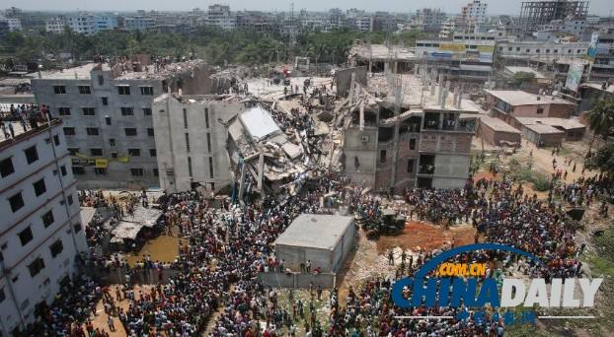

Slide 7
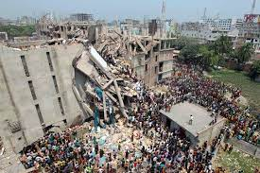

Slide 8
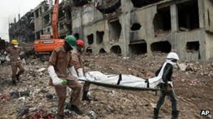

Slide 9
How?
Be Honest
Be Careful
Put Human beings first

Slide 10
Conclusion

Slide 11
Work Cited
https://www.nspe.org/sites/default/files/resources/pdfs/Ethics/CodeofEthics/NSPECodeofEthicsforEngineers.pdf
https://en.wikipedia.org/wiki/Leafcutter_ant
https://www.voanews.com/a/sunday-marks-third-anniversary-of-bangladesh-building-collapse/3300371.html
https://www.bbc.com/news/world-asia-22476774
https://www.ypppt.com/article/2021/7981.html
https://www.nytimes.com/2013/04/25/world/asia/bangladesh-building-collapse.html

